Slide 1
Reinforcement Learning
Travis Klipp, Evan Walker

Slide 2
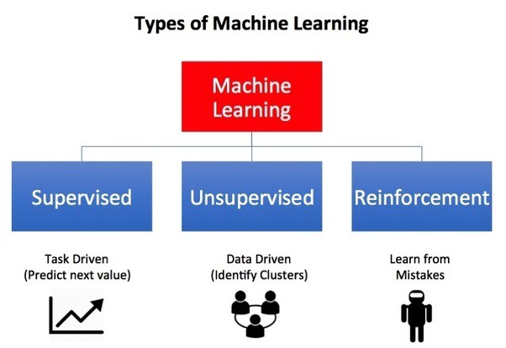
Reinforcement Learning Intro
What is Reinforcement Learning?
Trial and error interactions within an environment to maximize “reward”
Artificial Intelligence
Basic Framework
Agents
Environment
Reward
Action
Policy

Slide 3
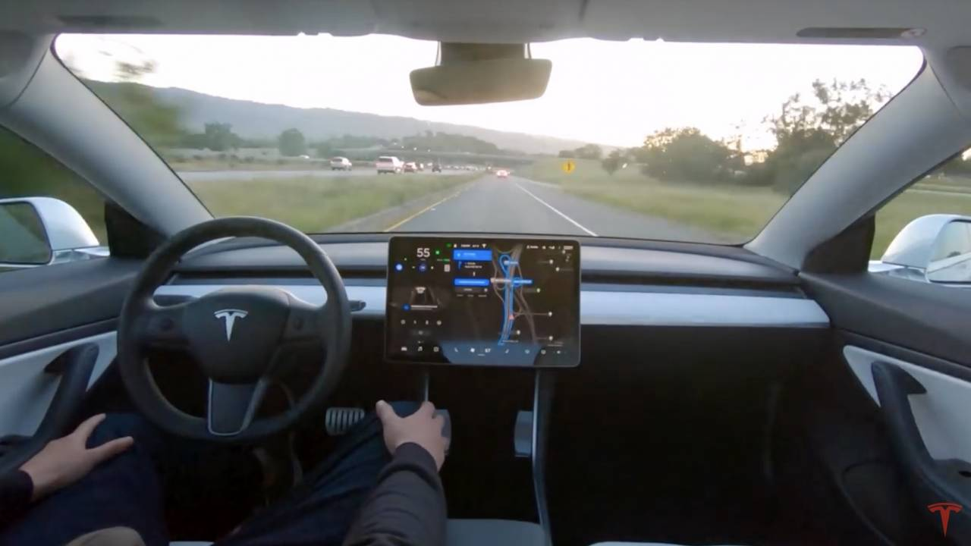
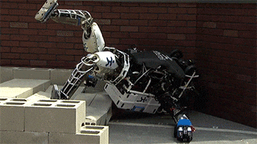
Notable Examples

Slide 4
Stateless Algorithms: Multi-Armed Bandits
Naive Algorithm
Action with highest payoff used forever
𝝐-Greedy Algorithm
Use best strategy as soon as possible
Upper Bounding Methods
More optimistic view, using statistical upper bounds on the payoff

Slide 5
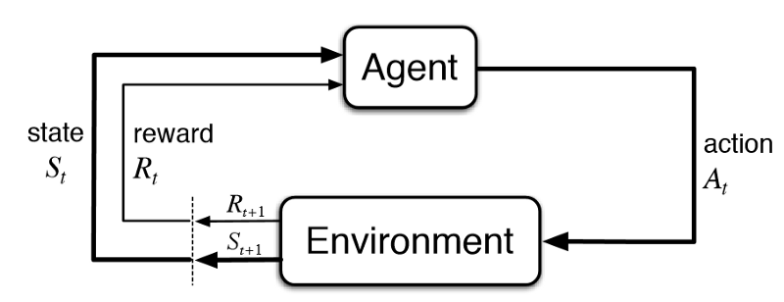
Reinforcement Learning with States

Slide 6
Challenges of Reinforcement Learning
Credit-assignment problem
The RL system may have a very large number of states
Trade-off between exploration and exploitation
Inability to gather sufficient data in real settings beyond simulated environments

Slide 7
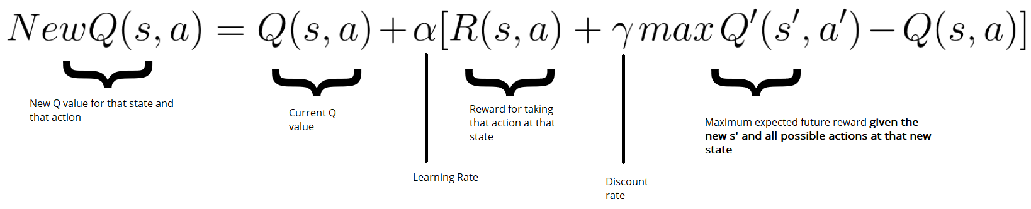
Q Learning Algorithm
A model-free form of Reinforcement Learning
Provides agents with the capability of learning to act optimally through the consequences of actions under different environmental circumstances
The Q-value is the expected discounted reward for executing action a at state s and following policy π
Q-Learning looks for the maximized reward to determine its next action

Slide 8
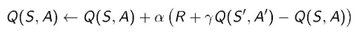
SARSA
“State-Action-Reward-State-Action”
Similar to Q-Learning, although the maximized future reward for the next state is not necessarily used when updating the Q-value
Instead, the next action, and therefore reward, are selected using the same policy that determined our previous action
Where s_t and a_t are the original state and action, and s_(t+1) and a are the new state-action pair
Alpha is our learning rate (between 0 and 1), and rho is our discount factor (between 0 and 1)

Slide 9
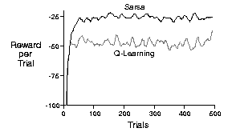
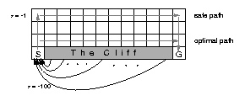
Q-Learning vs. SARSA
SARSA achieves a higher average reward per trial
Object S needs to get to block G. Object S is rewarded -100 points for falling off the cliff, and -1 point for taking the longest route on the top row
Q-Learning will take the “optimal path” along the cliff for maximized reward, but will occasionally fall off due to imperfect policies/nature
SARSA takes the “safe path” along the top row due to taking action selection into account

Slide 10
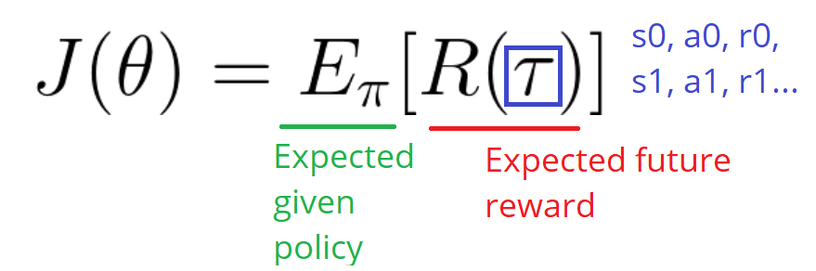
Policy Gradient Methods
Estimates the probability of each action at each step with the goal of maximizing the overall reward
Uses neural networks to estimate the policy/weights
Input is the current state, output is the set of probabilities associated with the various actions
Calculate expected discounted reward over a given horizon
Weights are obtained based on the reward of the action. Want to update the weight vector of the neural network along the gradient of increasing the award.

Slide 11
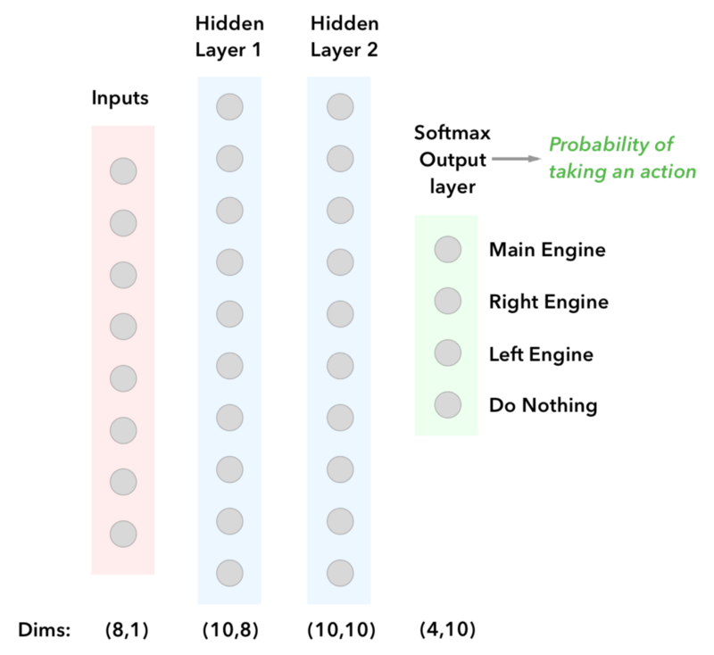
Policy Gradient Methods Cont.
Advantages
Very stable, good convergence properties
Can learn stochastic policies
More effective than Q Learning in high dimensional action Spaces
Disadvantage
Converges to local minima
Common Policy Gradient Methods
Finite Difference, Likelihood Ratio, Natural Policy

Slide 12
Other Common Algorithms
Monte Carlo Tree Search
Actor-Critic Algorithm
Deep Deterministic Policy Gradients
Proximal Policy Optimization

Slide 13
Proximal Policy Optimization Example
PPO is a family of policy optimization methods that use multiple epochs of stochastic gradient ascent to perform each policy update
PPO updates its policy conservatively in order to avoid adverse effects on its performance from one policy update to the next
PPO turns the divergence between the updated policy and the previous policy into a penalty term and uses it to optimize future policy selection
Other methods will use this divergence between the updated and previous policies as a learning rate, discount factor, etc.

Slide 14

PPO Example Cont: AWS Deepracer
Mini self-driving car created by AWS, train reinforcement learning algorithms online using Python/Tensorflow/AWS Sagemaker
Simulate in a virtual environment using a pre-made track, train model, load model into the car and calibrate
Algorithm recommended is the PPO algorithm, users can modify the algorithm, neural net hyperparameters, and create custom reward function
Compete with other racers globally

Slide 15
AWS Deepracer: First Attempt
Created custom reward function that penalized “zig zag” steering, moderately rewarded staying on the road, and increased speed to medium
Number of experience episodes between each policy-updating iteration to 20

Slide 16
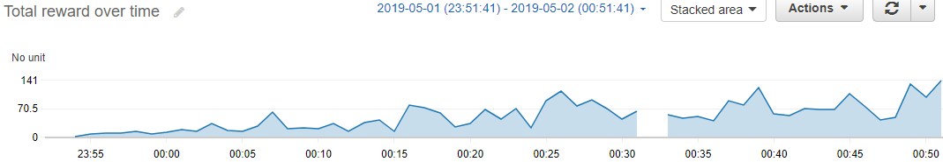
AWS Deepracer: First Attempt Results
Max reward obtained was 141 units, did not appear to reach convergence, only trained for one hour
When tested for 3 separate trials, the car completed each lap successfully averaging around 30 seconds

Slide 17
AWS Deepracer: Second Attempt
Created a reward function that still rewarded staying on the road and penalized zig-zag steering, but also increased the speed and rewarded the progress percent. The further along the car completed the lap, the heavier the reward
Trained for a longer period of time, increased gradient descent batch size

Slide 18
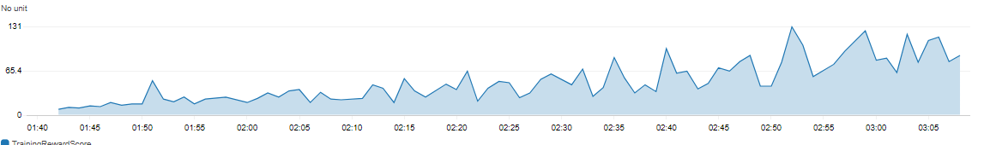
AWS Deepracer: Second Attempt Results
Completed 4 laps 10 seconds faster than the previous model, but failed for one lap
Appeared to start to reach convergence near the end of training
The increased speed likely caused the instability

Slide 19
References
Aggarwal. Neural Networks and Deep Learning. Springer, 2018.
A Beginner’s Guide to Deep Reinforcement Learning. https://skymind.ai/wiki/deep-reinforcement-learning#neural
Reinforcement Learning 101. https://towardsdatascience.com/reinforcement-learning-101-e24b50e1d292
Deep Reinforcement Learning--Policy Gradients--Lunar Lander. https://medium.com/@gabogarza/deep-reinforcement-learning-policy-gradients-8f6df70404e6
Reinforcement Learning Algorithms--Quick Overview. https://medium.com/@jonathan_hui/rl-reinforcement-learning-algorithms-quick-overview-6bf69736694d
An Introduction to Policy Gradients with Cartpole and Doom. https://medium.freecodecamp.org/an-introduction-to-policy-gradients-with-cartpole-and-doom-495b5ef2207f
Proximal Policy Optimization Algorithms. https://arxiv.org/pdf/1707.06347.pdf
AWS Deepracer Developer Guide. docs.aws.amazon.com/deepracer/

Slide 20
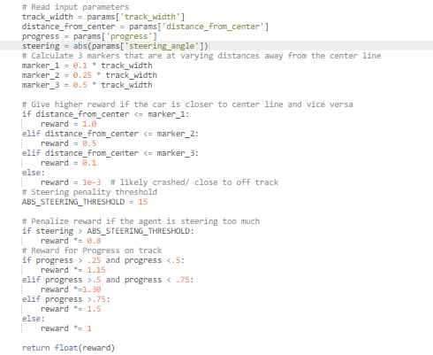
Reward Function

